Slide 1


From Me to (R)U
“By College Students, For College Students”
rupawning.com
Adrian Miedzybrodzki, Brandon Javier, Mikael-Ali Sheikh, Joshua Lee

Slide 2
Description of your Business Concept
Our organization focuses on convenience, ease-of-use, and authenticity—things that other similar services, such as Facebook Marketplace, doesn’t have. Services such as Facebook Marketplace or other online pawn shops have goods that are too far away. With our organization being placed on campus, every student will have access to these products even without a car (The buses provide enough transportation across all campuses). Additionally, services such as eBay or Facebook Marketplace are considered older platforms for many. This service will be catered by Rutgers students for Rutgers students, providing products that consumers know are real and worthy.
Notes:
Adrian

Slide 3
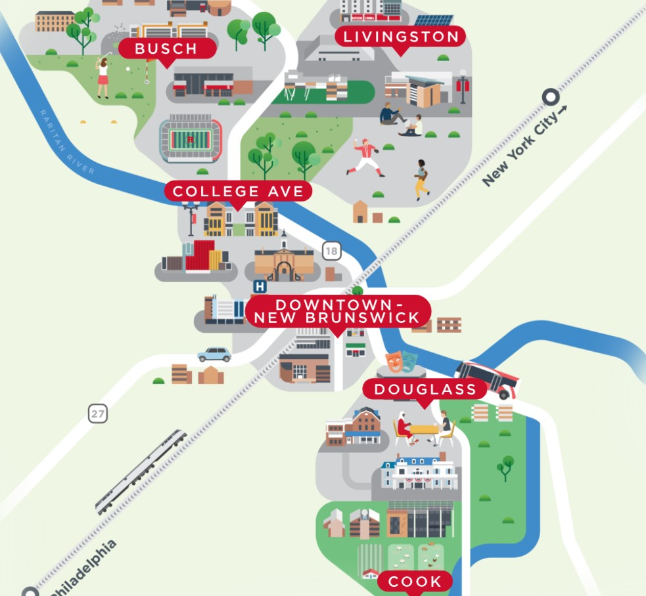
Customer Value Proposition
“By college students, For college students”
Convenient access (all on campus)
More student orientated
Make the website extremely easy
Creates a trustworthy environment—Safer and cheaper than other competitors
Notes:
Adrian

Slide 4
Vision Statement, Mission Statement, Statement of Core Values
Vision statement: Become the first place students go to look for affordable goods
Our mission is to serve students by offering fair and transparent pawn and resale services for authentic everyday items such as electronics, textbooks, and personal goods. We aim to provide short-term financial support and affordable purchasing.
Some core values our organization will focus on is the trust we place with our consumers, the authenticity of our products, and our cause-related marketing techniques to ensure the greatest customer satisfaction and value. We will create a trustworthy environment, providing products that are real and authentic
Notes:
Adrian

Slide 5
Financial and Strategic Objectives
Financial:
Achieve monthly sales revenue of $2,000 by the end of the first full semester (Fall 2026 semester)
,
Reach net income of $10,000 by the end of the fiscal year
Control expense costs below 70% of total revenue as our shop is mainly going to be over a website and we take % per item sold
Strategic:
Expand to each Rutgers Campus (Newark and Camden expansions) by year end 2026
Reach an average of 100 customers monthly by the end of the fiscal year
Reach social media marketing accounts (Tiktok, Instagram, and Facebook) to 5,000 followers by the beginning of the fall semester
Notes:
Adrian

Slide 6
Corporate Social Responsibility Key Initiatives and Rationale
Community Give-Back Program: Donate unclaimed items to local nonprofits. Shows social responsibility, strengthens community relationships and counters negativity we could face.
Make sure our business is eco-friendly: Whether it be the transport method or the products we sell, we ensure everything is eco-friendly which is an easy way to show we care about that customer base.
Make sure our business is ethical and fair in our pricing: We’re going to ensure our pricing is fair for students as most college students don’t have money to be throwing around.
Notes:
Adrian

Slide 7
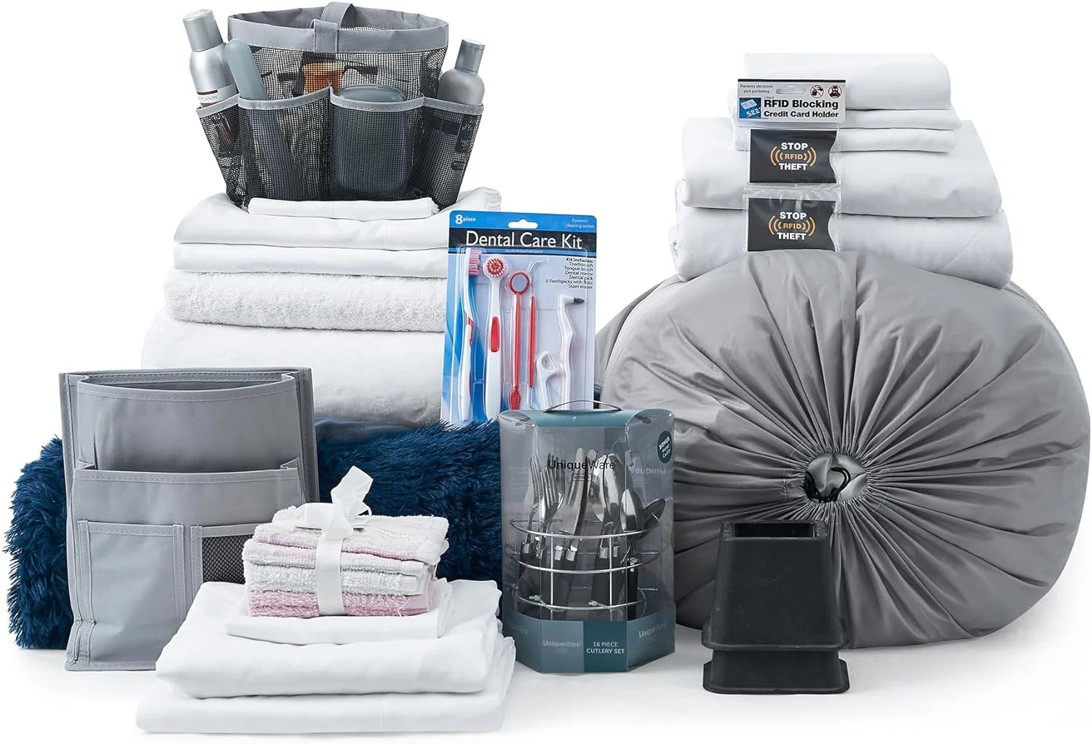
Description of New Product/Service selected by the team
A bundle kit for students coming into dorms might be a good venture for us to go into.
We can rely on
Use items sold in the previous semester to create a bundled package for incoming students
Have the bundle ready and set up before students arrive
Saves students time by eliminating the need to shop for each item individually
Offers added convenience, allowing for slightly higher pricing
Ensures profitability while providing a streamlined experience for students
Notes:
Josh
Bullet Points

Slide 8
National expansion decision, approach, and rationale
Yes—Expanding nationally might be a major opportunity for us, we should wait at least till the end of the fall semester in the later 2026 before we consider expansion.
This:
Allows time to test the business and gain hands-on experience
Helps Learn the process at the end of spring semester and start of fall semester
We should wait to fully manage both key periods before expanding
Expansion increases revenue and overall business value
Scaling the Rutgers model to other universities unlocks broader market potential
Notes:
Josh
Bullet Points

Slide 9
Canada
Opportunities
Challenges
Rationale
Very close
Major university opportunities
Similar legal system
Stable economic environment (GDP growth and legal protection of IP)
Very similar Power Distance and Uncertainty Avoidance score
  39-40 and 48-46, respectfully
  Reduces cultural risk
Currency translation
Language translation
Strict interest rate caps
Licensing requirements
Canada’s distance and similarity with the legal system mean that by far the best choice. The proximity means that we can still check the franchisees, which minimizes the risk of them causing us reputational damage since we are keeping an eye on them. It is most convenient as it has similar cultural conditions as America—they are close and speak same language, lots of legal enforcement, and not too much economic risk—which would mean we would require minimal changes in our business model.
Notes:
Brandon

Slide 10
Expansion strategy, Entry strategy, and rationale
Go Hybrid
Canada is very similar to America (very little customization needed), according to Hofstede’s Dimensions of Culture
Cost savings, efficient, no major changes needed, and allows for consistent core business values (we could adjust for small changes in the marketplace, but nothing that would take away from our core business and vision)
Joint-Venture
We can join businesses and reduce financial risk. Doing so leads to more university connections, easier licensing and more minds as you now share a business.
Additionally if we were to do a joint venture with the colleges and campuses themself, it would make integration that much easier (employees, promotional support, etc.)
Notes:
Brandon

Slide 11
Key job selected, summary of responsibilities, qualifications required, compensation plan, advertising plan, criteria for selection
Job: Store Clerk
Responsibilities:
Answering customers questions
Handling sales and giving change back (manages transactions)
Has receipt of all sales
Keep track of merchandise
Qualifications:
No necessary qualifications required, preferred students to let them develop skills
Compensation Plan:
Minimum wage
Advertising Plan:
Rutgers platforms (Handshake)
Job searching sites (LinkedIn, Indeed)
Social Media
Posters around campus
Criteria for Selection:
Did the applicant provide a complete application
Any prior retail, cash-handling, or customer service experience
Provides a resume
Notes:
Fix the styling. Josh

Slide 12
Employee motivation initiatives
Flexible Scheduling
  autonomy and work-life balance
Bi-Annual Salary Promotions
  physiological needs, security, and growth
Anonymous Suggestion box
  psychological safety and organizational belonging
Benefits (such as reserved parking)
  convenience perks and general happiness
Employee of the Month (Praise as well as bonus)
  extrinsic (money) and intrinsic (recognition) motivators
Notes:
Brandon

Slide 13
Key Employees Departure Announcement
Dear Current Employees,
It is with a heavy heart to announce the departure of two of our employees; however, to promote greater morale within the company, here are some of the benefits that staying with us provides.
We provide flexible scheduling to all employees—we understand many of you are students with busy schedules and we value your time and academics.
Another thing we are adding in the hopes that we never have to deal with these unfortunate departures again is suggestion spots. All of you will be able to provide anonymous suggestions for improvements or issues you see, and hopefully, you will never have to resign in order for your voice to be heard.
This job isn’t without benefits either: by being a loyal employee of our business, you receive campus privileges, such as free private parking on campus lots and office perks.
Working hard pays off with us as employee of the month bonuses are provided. These bonuses can range from wage increases, extra cash, public shoutouts, and more. In addition to these benefits, a raise every six-months is expected for all of our employees.
With these, we hope for you to value our company and for us to not only gain your respect but your loyalty as well.
Kind Regards,
Your Boss
Notes:
Fix the styling. Josh

Slide 14
Key actions selected to achieve high levels of employee engagement
Provide strong leadership and clear communication
Offer professional opportunities
Promote collaborative team culture
We’d create formal and anonymous complaint system as well as a place for employees to provide constructive suggestions, allowing for their voices to be heard and be impactful
We would provide employees with the authority and resources to start projects without management cues
Notes:
Mikael Ali

Slide 15
SIPOC
Suppliers | Inputs | Processes | Outputs | Customers
University Students Donators Alumni The University Local Labor Market Online Marketplace | Physical location with space to hold and advertise our goods Trained employees Marketing/ advertising Used goods | Collect/source inventory from suppliers Organize items and check quality Market the goods Sell quality items | Friendly service Good deals for items Quality goods that genuinely help Purchased inventory | Who: Rutgers Students Desired Customer Behaviors: - Repeated business - Referrals - High ratings - Infrequent returns Customer requirements: - Quality goods and accurate goods Fair valued goods - Good service - Ease of purchase
Notes:
Mikael Ali Sheikh

Slide 16
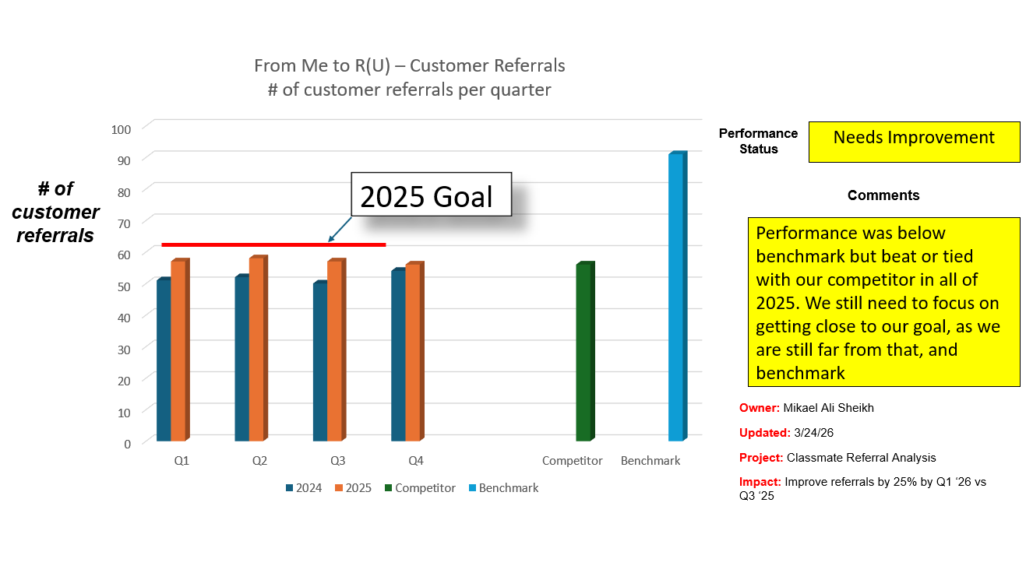
Effectiveness Measurement Chart
Notes:
Mikael Ali Sheikh

Slide 17
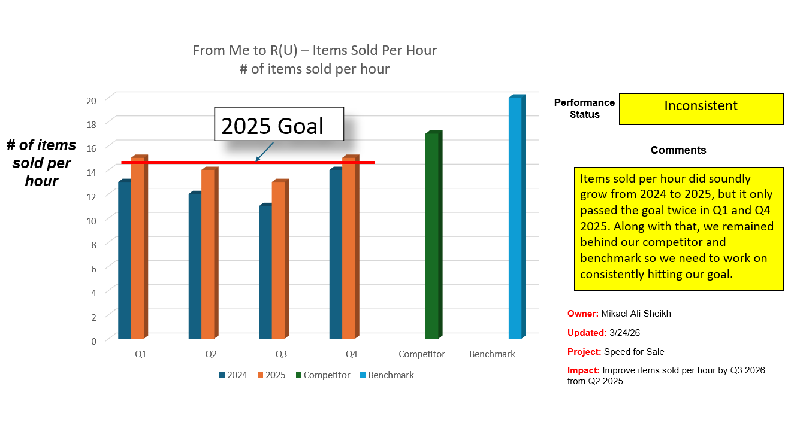
Efficiency Measurement Chart
Notes:
Mikael Ali Sheikh

Slide 18
Key Initiative to Improve the Process
Create an employee training program to help our employees on the sales floor get customers to make more purchases
  Allows our employees to have training on how to increase sales while catering to our customers’ needs and budget
Pick up items from suppliers directly to get brand-new items in stock
  This will add new inventory, exciting customers, and include a new input of suppliers, both of which will help get students who are weary on used items
Adding a loyalty program, such as a membership club or punch cards with a discount after 10 visits
  Gives us a way to show how we value our customers and give discounts to our loyal ones
Notes:
Mikael Ali Sheikh
Bullet Points

Slide 19
To Sell, or Not to Sell
We Will Not Sell
While the agreement is attractive, and we have our stockholders to keep in mind,
New owners have no experience or connection— its just a “fun” investment
CSR commitments won’t be upheld
Risk for our customers, employees, suppliers, and business partners
  Loss of jobs, poor leadership, etc.
Notes:
Brandon
While the cash and consulting agreement is attractive, along with our obligation to stockholders being important, selling our business will harm our stakeholders too much to agree. The new owners have no experience in a business like this and have no personal connection to the business, as they view it as a “fun” investment. Furthermore, our CSR commitments won’t be upheld by these new owners if only the stockholders are solid to gain in the short term. Our customers, employees, suppliers, and business partners may have to deal with major consequences with no protection to help them. Selling the business has horrible long-term consequences that outweigh the short-term benefits. Selling the business would lead to the loss of jobs, negatively affecting communities, employees, and more. Depending on the new owner, there can be a lack of leadership, leading to the company failing. Although shareholders would benefit, profit isn’t all that matters when it comes to running the business.

Slide 20
Summary of Success
Our business has succeeded through our efforts of bridging the gap between convenience and community. Through the convenience and accessibility of our products, the trust and authenticity of our brand, our proven growth and performance, as well as our commitment to our community and our social responsibility, we have proven our success as a company and provided strong enough roots to expand beyond.
Notes:
Brandon

